Slide 1
Jermyn Borough Council Meeting
10/1/20

Slide 2
Meeting Agenda
Call to Order
Pledge of Allegiance
Roll Call
Previous Meeting Minutes
Bills Payable
Correspondence
Public Comment
Jermyn Borough Climate Action Plan Presentation – Dr. Marleen Troy, Ian Barchock, Dylan O’Connor – Wilkes University
Resolution to Adopt Climate Action Plan
Follow Up on Garfield Ave Stop Signs
Halloween
Rental Application/Permits
New Business
Adjournment

Slide 3
Treasurer’s report
October 1, 20
ASSETS
Capital Reserve - DPW 13,426.77
Capital Reserve - Police 1,834.29
Crime Watch Fund 921.75
General Fund - Community 112,065.90
General Fund - FNB 1,925.11
Holiday Lights Fund 543.90
Investment - General Fund 1.39
Investment - Liquid Fuels 34,283.67
Investment - Paving Fund 11.91
Investment - Recycling 1.33
Investment - Refuse 2,602.90

Slide 4
Treasurer’s report
Liquid Fuels - FNB 39,996.44
Petty Cash 162.01
Recreations Fund 5,277.78
Recycling - Community 13,163.91
Refuse Checking - FNB 65,109.96
Total Checking/Savings 291,329.02

Slide 5
Treasurer’s report
LIABILITIES & EQUITY
Current Liabilities
Accounts Payable 17,284.74
Other Current Liabilities
210.00 · Withholding - Federal Income Tx 4,712.20
211.00 · Withholding - Social Security 5,785.15
212.00 · Withholding - Local Tax 583.50
213.00 · Withholding - Medicare 1,353.00
217.00 · Withholding - State Tax 1,432.28
221.00 · Withholding - PA Unemployment 153.75
Total Other Current Liabilities 14,019.88
Total Liabilities 31,304.62

Slide 6
Jermyn Borough Climate Action Plan
October 1, 2020

Slide 7
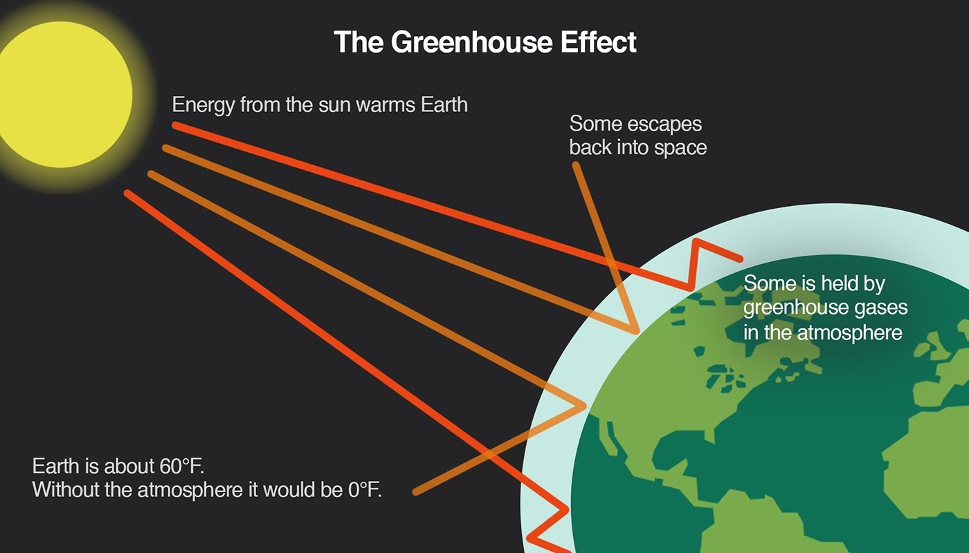
Climate Change
https://www.uml.edu/sustainability/Practices/air-climate/Greenhouse-Gas-Information.aspx

Slide 8
Sources of Greenhouse Gases
Transportation (28.2%) : Fossil fuel combustion from cars, ships, trains, and planes.
Electricity (26.9%) : Fossil fuel combustion accounts for 63% of electricity production.
Industry (22%) : Fossil fuel combustion to provide electricity.
Residential (12.3%) : Fossil fuel combustion to provide heat.
Agriculture (9.9%)
Land Use and Forestry (11.6%)
Notes:
EPA.gov 2018

Slide 9
What is a Climate Action Plan?
Greenhouse gas emissions
Emissions reduction goals
Action plan
  Resilience strategies, Clean Energy targets, Economic goals, Social/Equity goals
PADEP Climate Action Goals
  26% reduction in GHG emissions by 2025
  80% reduction in GHG emissions by 2050

Slide 10
Local Municipalities
UGI
PPL
Lackawanna County Waste

Slide 11
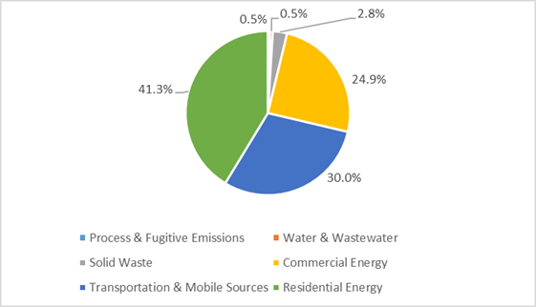
Jermyn Greenhouse Gas Emissions

Slide 12
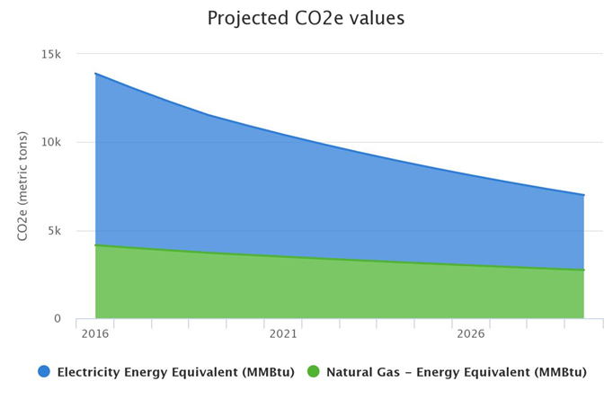
Projected Growth in Residential GHG Emissions from 2016 to 2030

Slide 13
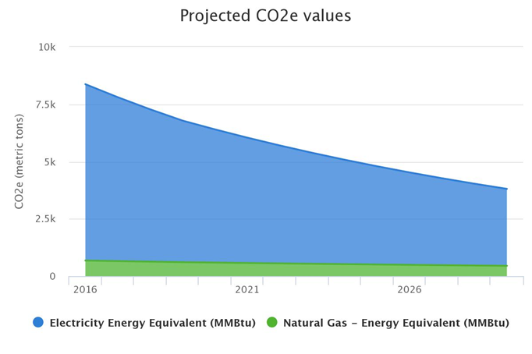
Projected Growth in Commercial GHG Emissions from 2016 to 2030

Slide 14
Residential Buildings
Retrofit existing buildings and homes to achieve 10% reduction in energy use by 2030
Increase number of weatherized homes
Ensure new structures are built to maximize energy efficiency
Offer financing vehicle to residents for energy retrofits
Increase residential uptake of utility incentives for energy efficiency

Slide 15
Residential Buildings - Green Energy
Increase support to residents for installing small-scale renewable energy systems
  Community partners
  Offer financing to small commercial properties
Supply 10% of local government energy demand from local renewable energy generation
  Renewable energy systems on borough buildings
  Agreement with PPL
Notes:
Community partners to finance and install renewables on large-scale private facilities.

Slide 16
Waste, Composting, & Recycling
Reduce solid waste generation by 10%
Increase recycling activities by 10%
Establish a Building Materials Reuse Warehouse

Slide 17
Challenges
Lack of Transportation historical data
Limited data for other parameters
COVID-19

Slide 18
Next Steps
Community Outreach Event
Improve data collection

Slide 19


Thank you

